Slide 1
Research & Low Power SRAM
Everestus Ezike, Zhiqi Hao, Haolan Zhan
Team Name: 4

Slide 2
Project Description
Minimizing power (dynamic and leakage) is essential for many SRAM applications, including AI, smart vehicles, and IOT
Our project involves researching and implementing a lower power 8x8 SRAM array
Additionally, a row decoder and necessary column circuitry will be incorporated to successfully perform byte sized read/write operations
Schematics and layouts of each component in our SRAM design created in Cadence Virtuoso will be tested through simulation
The column circuitry consists of a pre-charge, write circuitry, and sense amplifier unit
Since the 8x8 SRAM array allows for 8 possible memory locations, each with 1 byte of memory, a 3-bit address provided by the row decoder as input to access particular memory cells is required
Notes:
Haolan

Slide 3
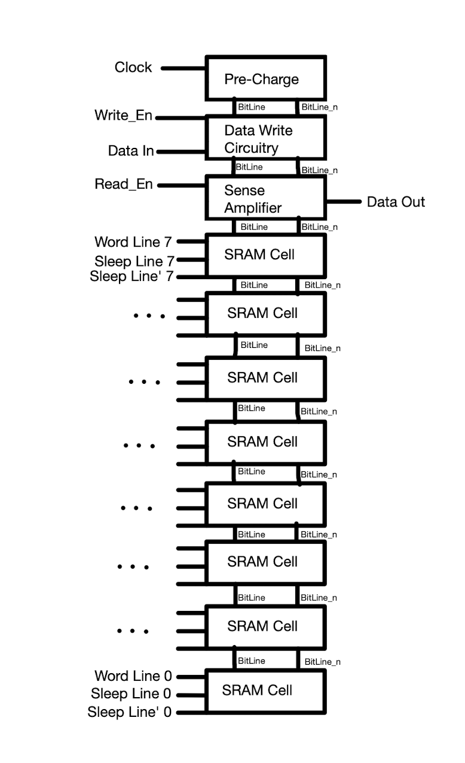
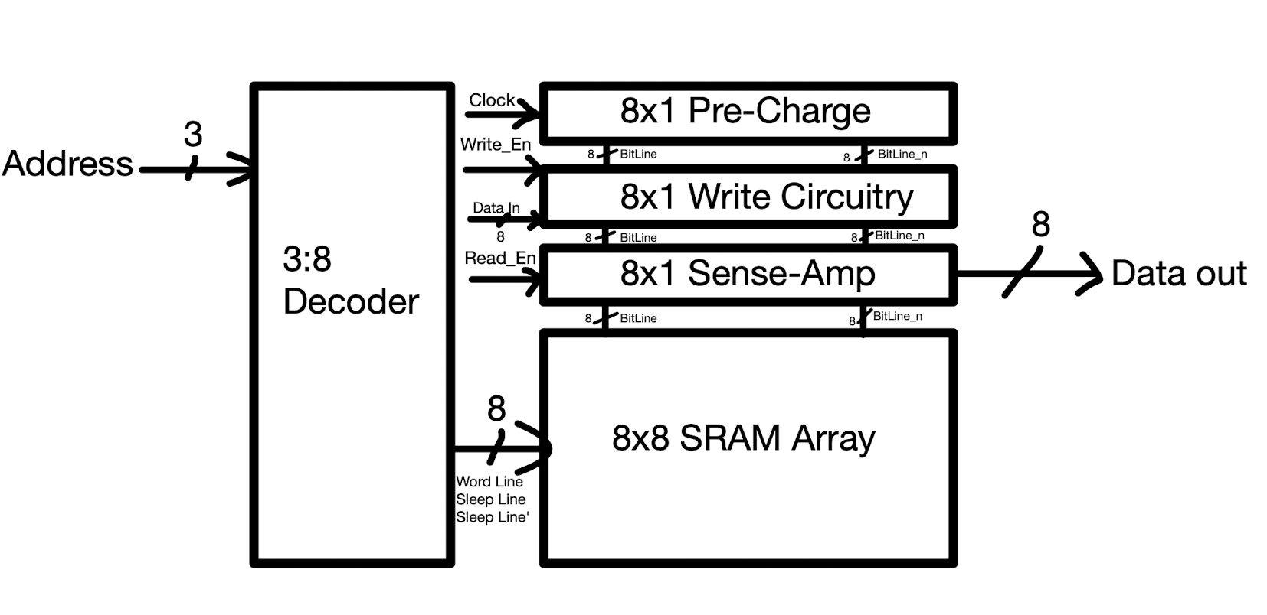
Block Level Overview
Notes:
everestus

Slide 4
Tasks by person
Everestus Ezike | Schematic and layout of Write Circuit, Precharge, 8x8 SRAM array, Sense Amplifier
Zhiqi Hao | Schematic and layout of SRAM cell and Write Circuit
Haolan Zhan | Schematic and layout the Decoder and SRAM Simulations
Notes:
everestus

Slide 5
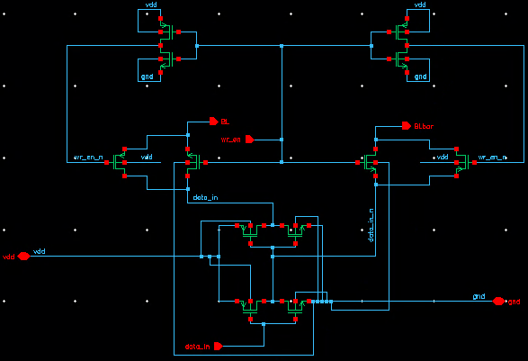
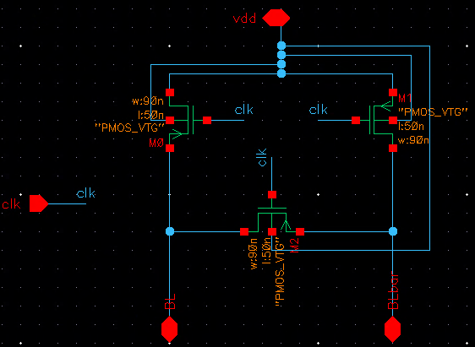
Single Cells of System Architecture
Write Circuit
PreCharge
Notes:
agnes

Slide 6
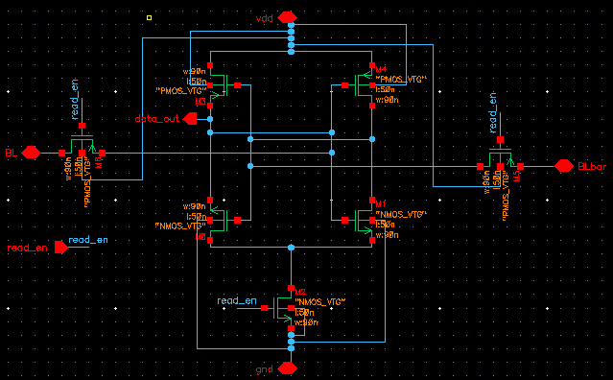
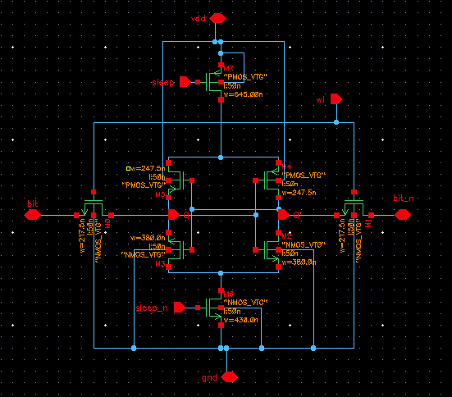
Sense Amplifier
6T MTCMOS SRAM Cell
Notes:
agnes

Slide 7
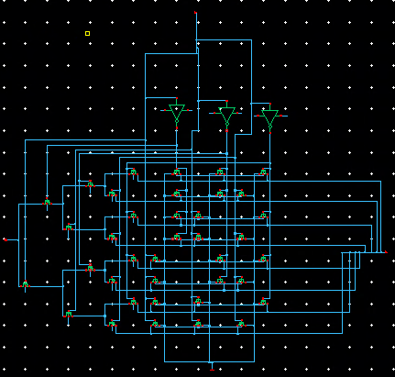
Row Decoder
Notes:
Haolan

Slide 8
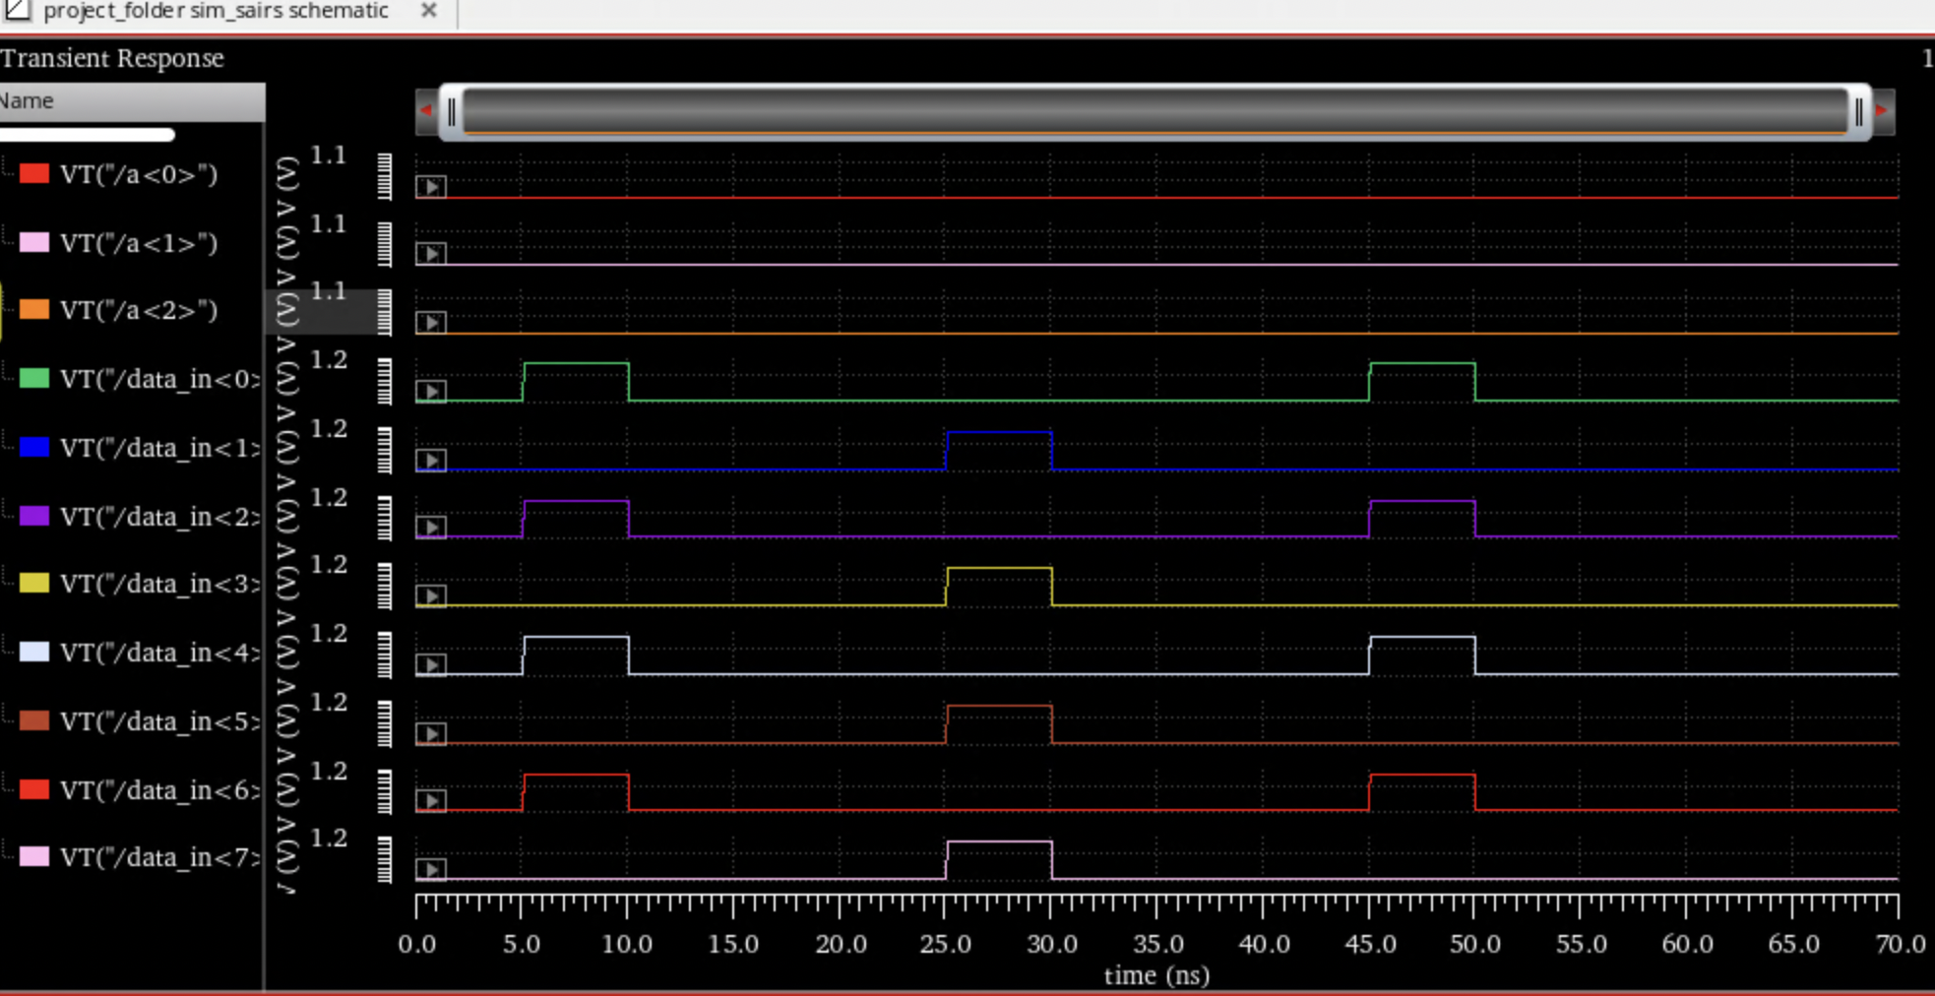
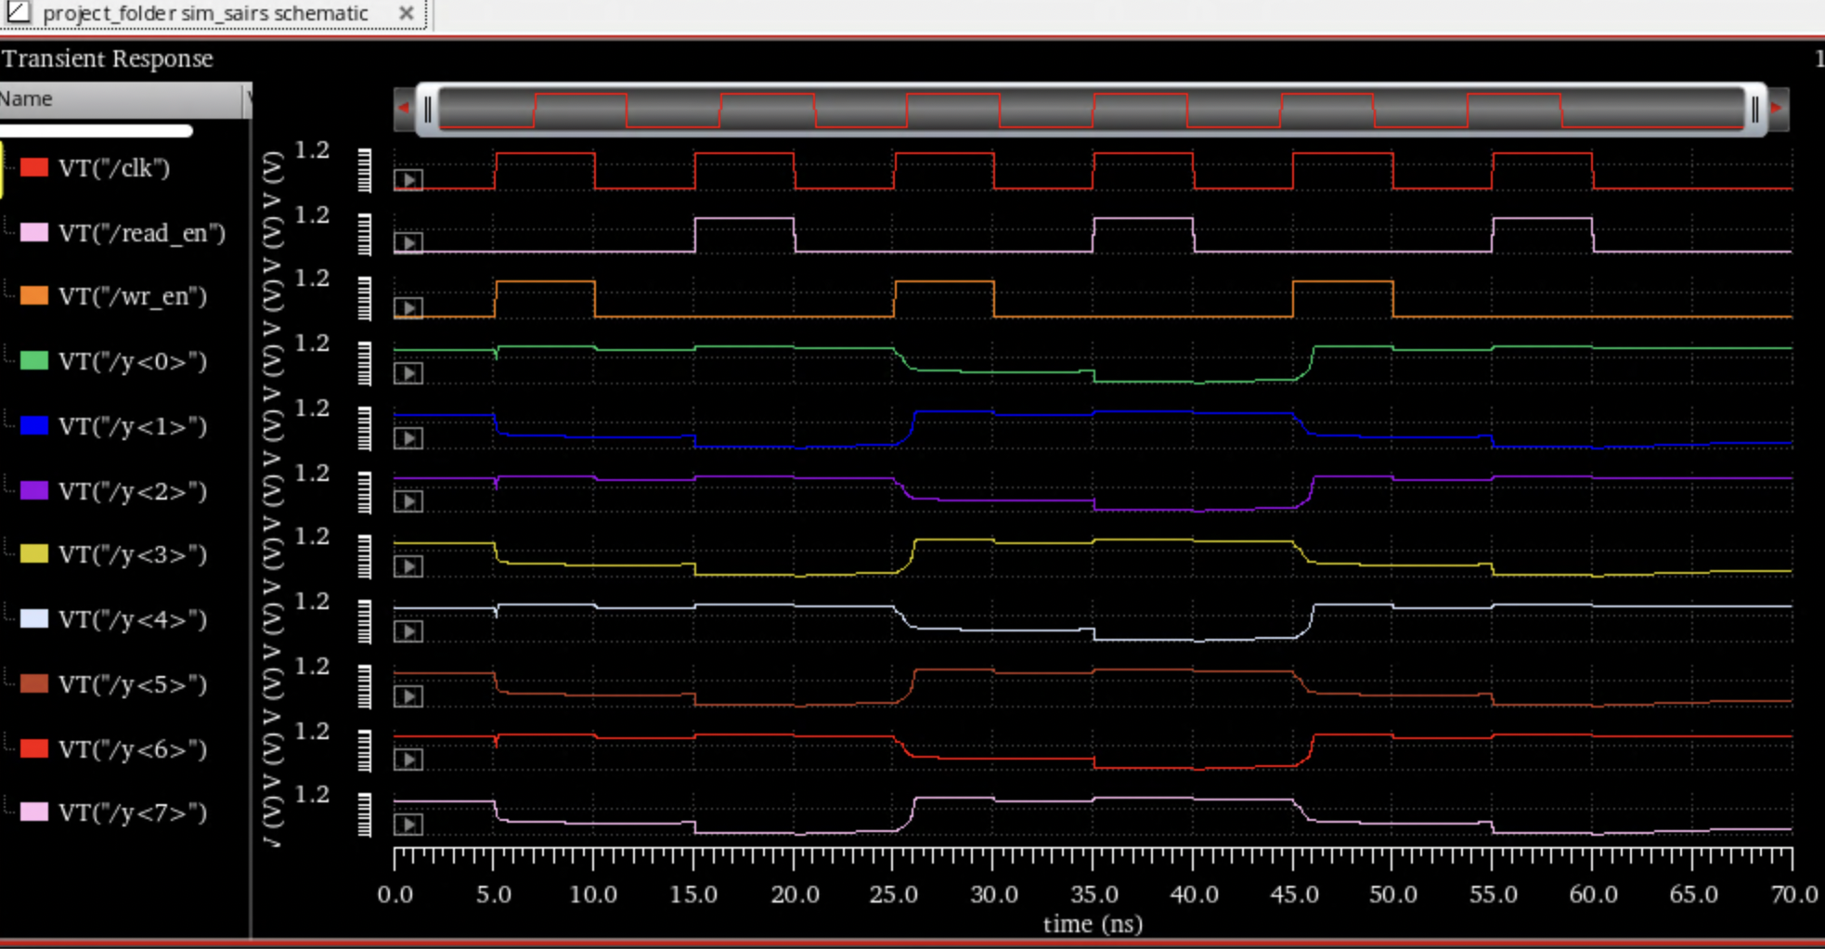
Simulation
Inputs:
Clk, Read_en, Write_en, Address[0:3], Data_in[0:7]
Outputs:
Data_out[0:7]
Simulation
Write 10101010 into address 0
Read from address 0
Write 01010101 into address 0
Read from address 0
Write 10101010 into address 0
Read from address 0
More tests will be done in the demonstration
Notes:
Haolan

Slide 9
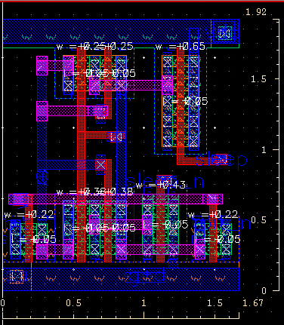
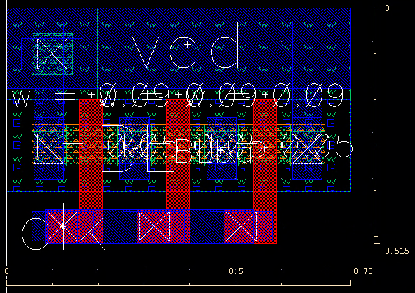
Layout/Implementation
6T MTCMOS SRAM Cell
PreCharge
Notes:
everestus

Slide 10
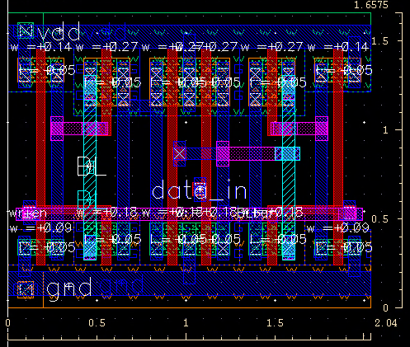
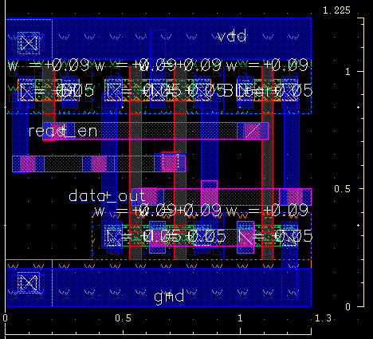
Layout/Implementation
Sense Amplifier
Write Circuit
Notes:
everestus

Slide 11
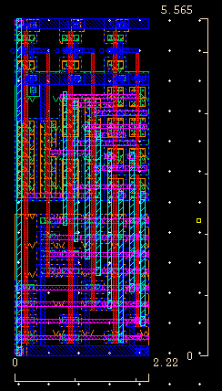
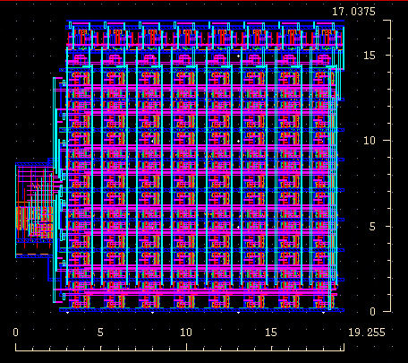
Final Layout/Implementation
Notes:
everestus

Slide 12
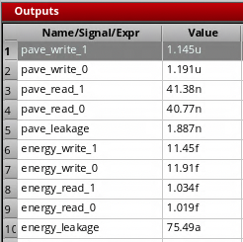
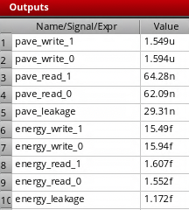
Design Optimizations/Results
<- With Power Gating
SRAM cell (with power gating transistors) power usage optimization compared to traditional 6T SRAM Cell
Average Power to write a 1: 26.08% decrease
Average Power to write a 0: 25.28% decrease
Average Power to Read a 1: 35.63% decrease
Average Power to Read a 0: 34.34% decrease
Average Leakage Power: 93.56% decrease
Decoder design optimization
70 -> 44 transistor design
Sense Amplifier optimization
Power gating transistor
Without Power Gating ->
Notes:
Haolan

Slide 13
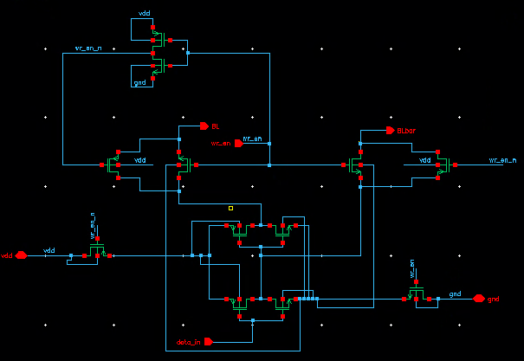
Future Work
Power Gating the Write Ciruitry
Removing redundant inverter in Write Circuitry
Figure out way to remove need of transmission gate in Write Circuitry
Implement a similar power gating design with a 8T base design
Make a larger SRAM array (more than 64 bits) - will need more components such as Column Decoders
Notes:
agnes

Slide 14
Have A Good Holiday
References
[1] N. H. E. Weste and D. M. Harris, CMOS VLSI Design: A circuits and systems perspective, 4th ed. Addison-Wesley, Boston: Pearson Education, Inc., 2011.
[2] R. K. I. Kumar, V. C. Kalal, H. P. Rajani, and S. Y. Kulkarni, “Design and Verification of Low Power 64bit SRAM System using 8T SRAM:Back-End Approach,” International Journal of Engineering and Innovative Technology, vol. 1, no. 6, pp. 1–7, Jun. 2012.
[3] A. Bhaskar, "Design and analysis of low power SRAM cells," 2017 Innovations in Power and Advanced Computing Technologies (i-PACT), 2017, pp. 1-5, doi: 10.1109/IPACT.2017.8244888.
[4] Y. Kim, S. Patel, H. Kim, N. Yadav, and K. K. Choi, “Ultra-Low Power and High-Throughput SRAM Design to Enhance AI Computing Ability in Autonomous Vehicles,” Electronics, vol. 10, no. 3, p. 256, Jan. 2021, doi: 10.3390/electronics10030256.
[5] D. Yagain, A. Parakh, A. Kedia and G. K. Gupta, "Design and Implementation of High Speed, Low Area Multiported Loadless 4T Memory Cell," 2011 Fourth International Conference on Emerging Trends in Engineering & Technology, 2011, pp. 268-273, doi: 10.1109/ICETET.2011.23.

